Slide 1
Lecture 16
Precision of Point Estimators and The Sampling Distribution
Unbiased Estimators

Slide 2
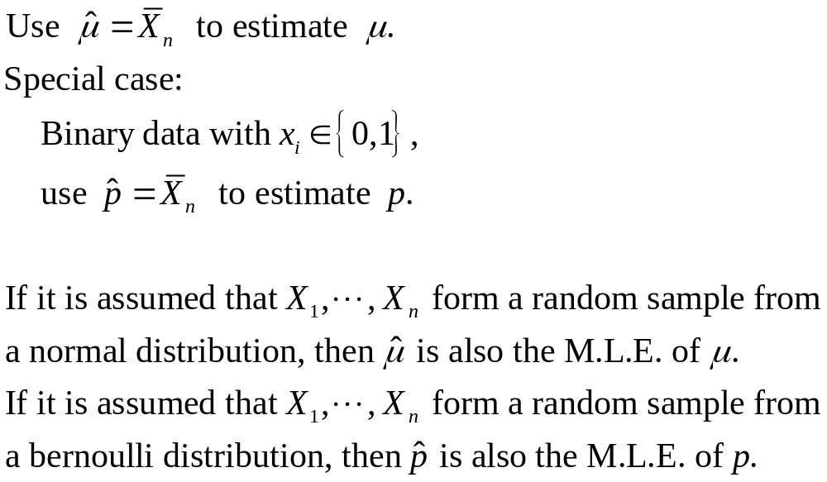
Precision (精度) of Point Estimators

Slide 3
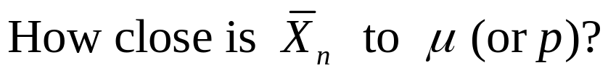
Precision of Point Estimators
Can we answer the following question:
How close is the sample mean RMB 3950 to the mean monthly household income for all peasant workers in Beijing ?
How close is the sample proportion 26.9% to the proportion of having social insurance for all peasant workers in Beijing?

Slide 4
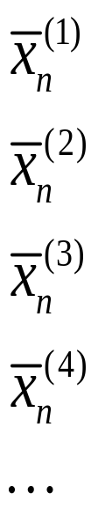
Precision of Point Estimators
1419
1419
1419
1419

Slide 5
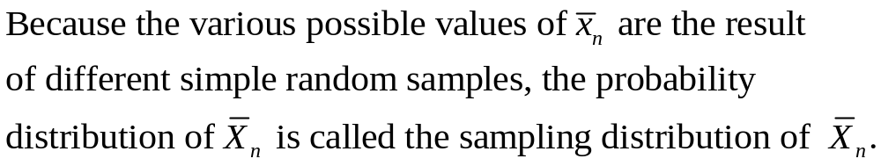
Key Tool for Statistical Inference:
Sampling Distribution (抽样分布)
1419
1419
1419
1419

Slide 6
The Sampling Distribution of A Statistic
Suppose that X1,…,Xn form a random sample from a distribution involving a parameter θ whose value is unknown.
Statistic: any real-valued function T=r(X1,…,Xn) of the variables X1,…,Xn.
  T is itself a random variable.
  Its distribution is often called the sampling distribution of the statistic T since it is derived from the joint distribution of the observations in a random sample.
δ (X1,…,Xn) as an estimator of θ is also a statistic.
  It is possible to derive the sampling distribution of any estimator of θ.

Slide 7
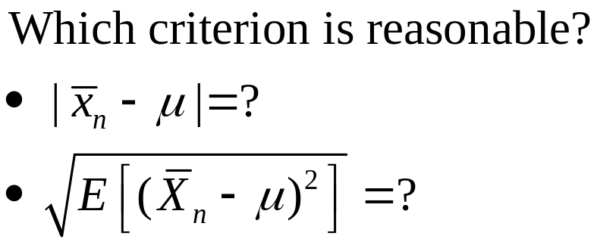
Precision of Point Estimators

Slide 8
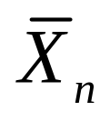
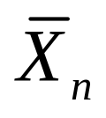
Some Knowledge about
Even without knowing the exact form of the sampling distribution, statisticians can already calculate the mean, variance and standard deviation of .

Slide 9
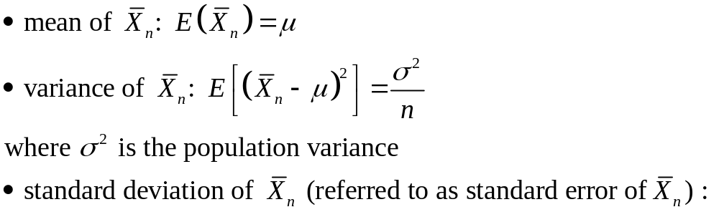
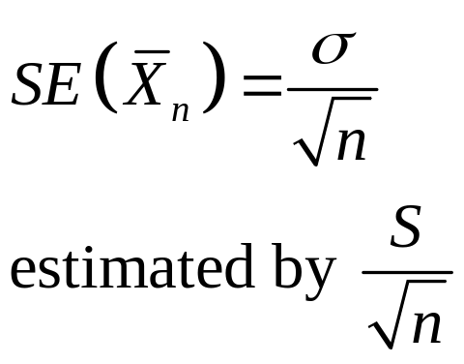
Mean, Variance and Standard Error (标准误差) of
Insights:
SE is related to sample size
SE is related to population variance

Slide 10
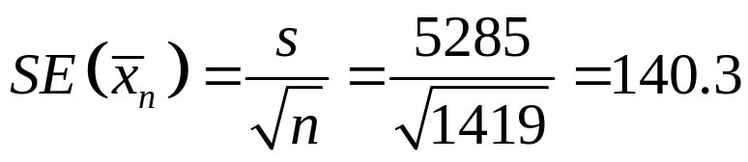
Example 1
The standard error of sample mean of monthly household income is estimated to be
Notes:
dfghdfghfdghgfhdfghdfgh

Slide 11
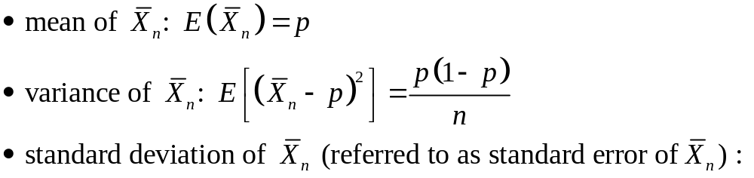
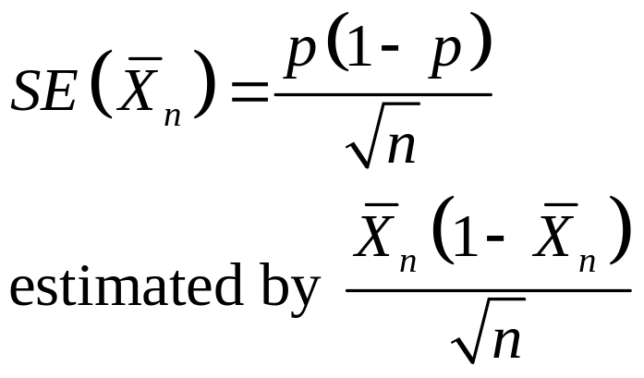
Special Case: Binary Data
Insights:
SE is related to sample size
SE is related to population proportion

Slide 12
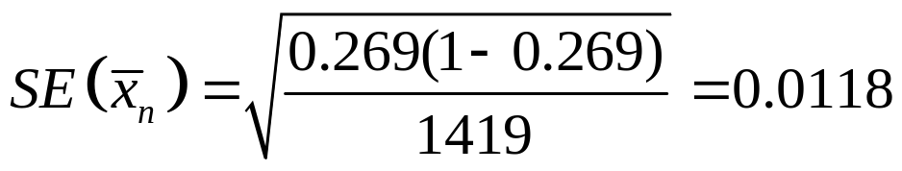
Example 2
The standard error of sample proportion of having social insurance is estimated to be
Notes:
dfghdfghfdghgfhdfghdfgh

Slide 13
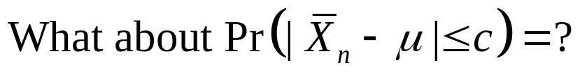
Another Way of Characterizing Precision

Slide 14
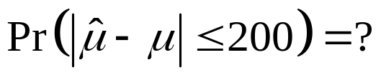
Example 1
What is the probability that the sample mean of monthly household income computed using a simple random sample of 1419 peasant workers in Beijing will be within RMB 200 of the population mean, i.e.,
Notes:
dfghdfghfdghgfhdfghdfgh

Slide 15
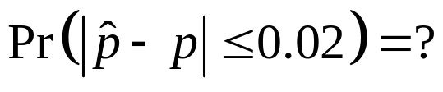
Example 2
What is the probability that the sample proportion computed using a simple random sample of 1419 peasant workers in Beijing will be within 2 percent of the population proportion, i.e.,
Notes:
dfghdfghfdghgfhdfghdfgh

Slide 16
More Knowledge Is Needed
We need to know the form of the sampling distribution.

Slide 17
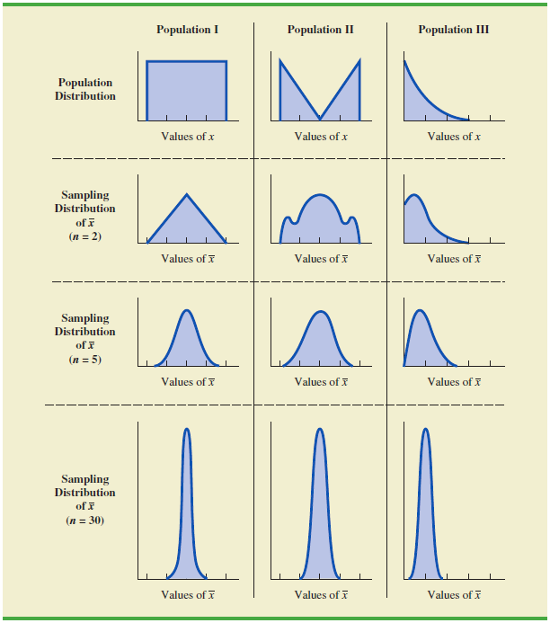
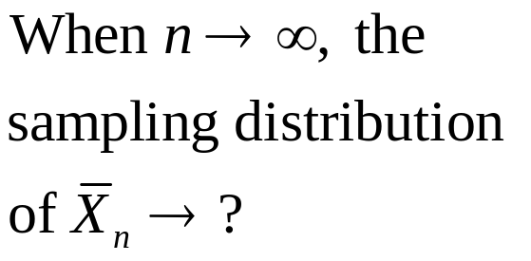
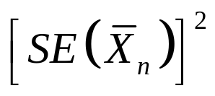
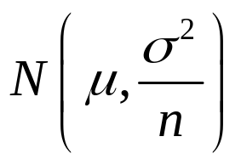
Using Central Limit
Theorem (Loosely)
Notes:
dfghdfghfdghgfhdfghdfgh

Slide 18
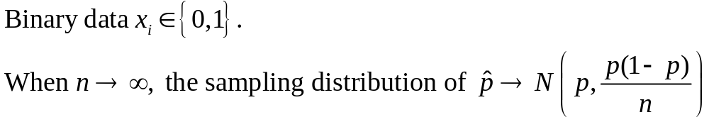
Special case of the Central Limit Theorem
Notes:
dfghdfghfdghgfhdfghdfgh

Slide 19
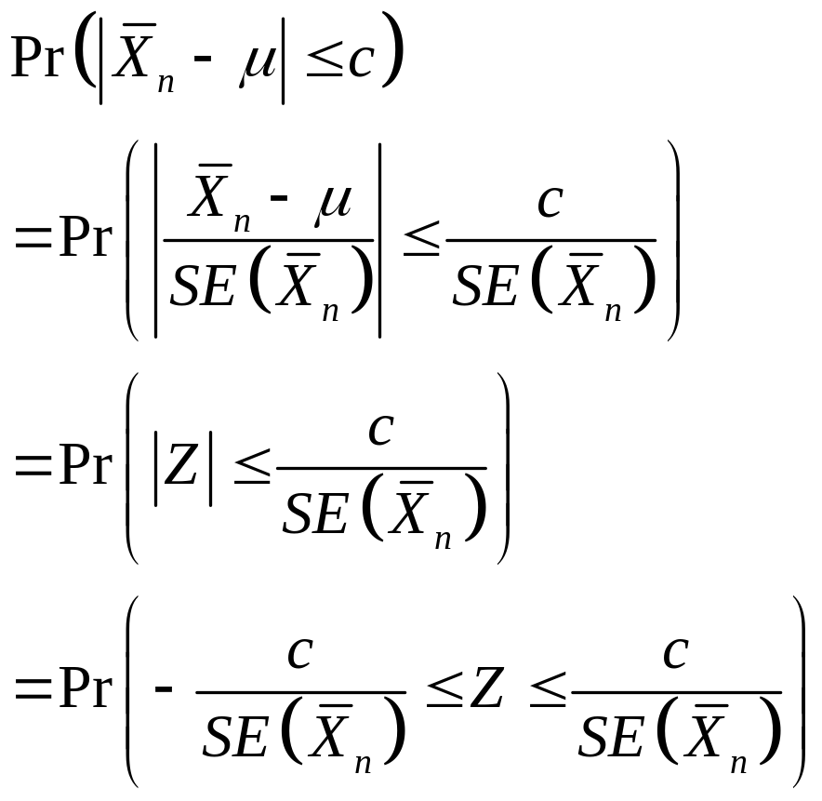
The Probability Now Becomes…

Slide 20
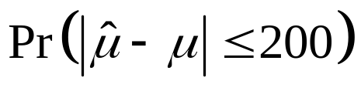
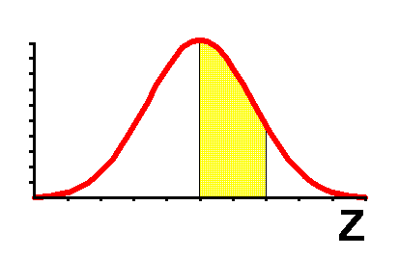
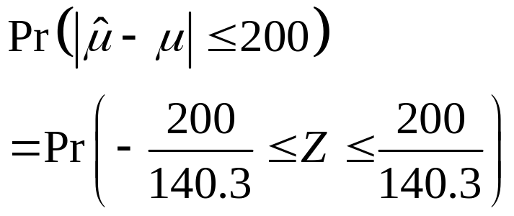
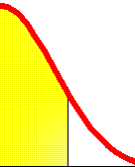
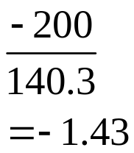
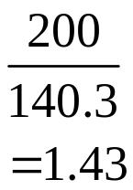

Solution for
0.9236-(1-0.9236)
=0.8472

Slide 21
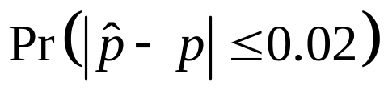
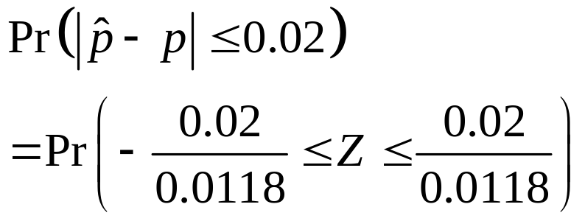
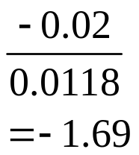
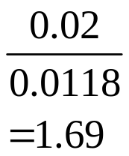
Solution for
0.9545-(1-0.9545)
=0. 909

Slide 22




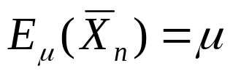
Unbiased Estimators
Definition: An estimator is an unbiased estimator of a parameter if
for every possible value of .
E.g. Suppose that X1,…,Xn form a random sample from any distribution for which the mean μ is unknown. The estimator satisfies that , so it is an unbiased estimator.

Slide 23




Sampling Distribution of
Sampling Distribution of
Bias
Unbiased Estimator
Biased Estimator

Slide 24


Unbiased Estimation of a Function of θ
Definition: An estimator is an unbiased estimator of a parameter if
for every possible value of .

Slide 25

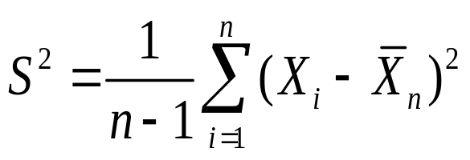
Unbiased Estimation of the Variance
If the random variables X1,…,Xn form a random sample from any distribution for which the variance is unknown, then the estimator
will be an unbiased estimator of .

Slide 26
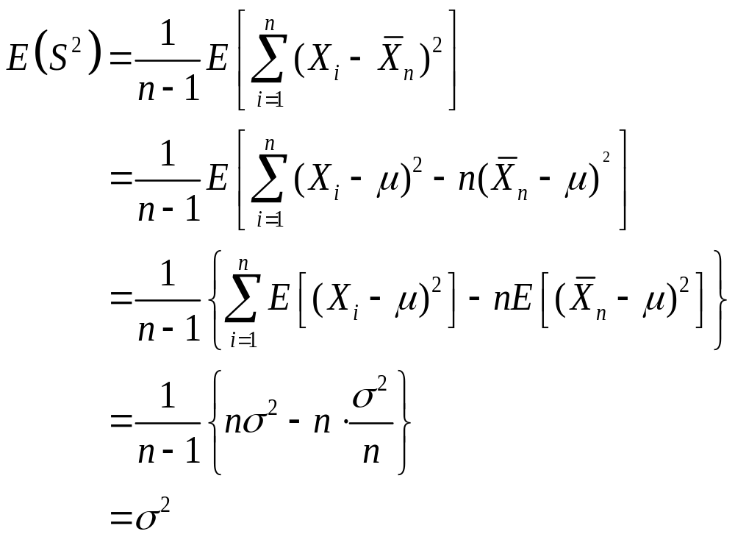
Proof.

Slide 27
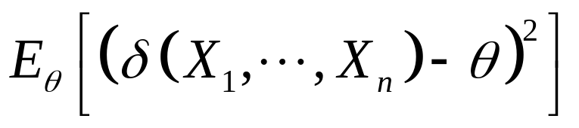
Mean Squared Error
We are often interested in the mean squared error (MSE) for an estimator:

Slide 28
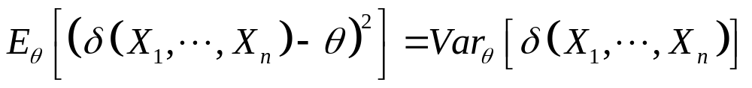


Comment 1
If an estimator δ is unbiased, then its MSE is equal to its variance:
Even with unbiaseness, we want to seek small variance.
Sampling Distribution of
More preferable!
Sampling Distribution of

Slide 29
Comment 2
In many problems, there will exist a biased estimator that has a smaller MSE than any unbiased estimator for every possible value of the parameter.

